Slide 1

React JS

Slide 2
Introduction to React Component
Module

Slide 3
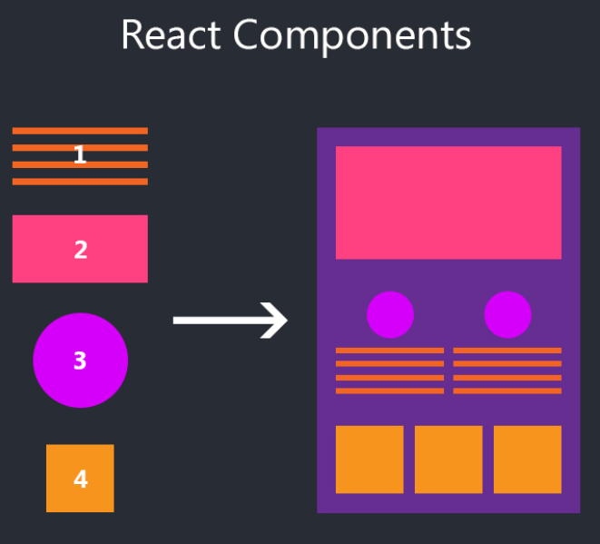
React Components
Text Component
Header
Header Component
Advertisement images
Advertisement Image List Component
Texts
Item List Component
List of items

Slide 4
Component
Components let you split the UI into independent, reusable pieces, and think about each piece in isolation (Official)
Conceptually, components are like JavaScript functions

Slide 5
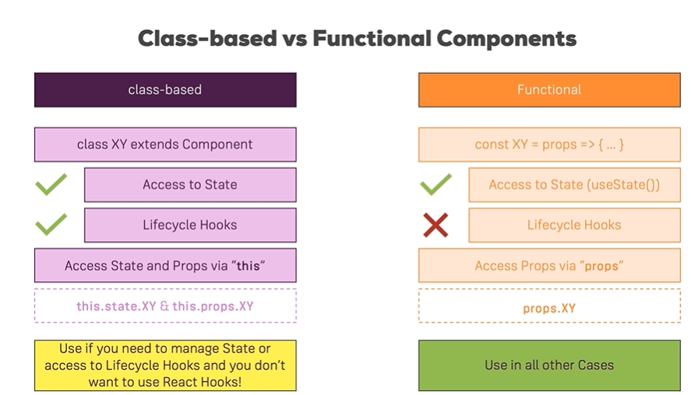
Class Components vs. Functional Components

